Slide 1
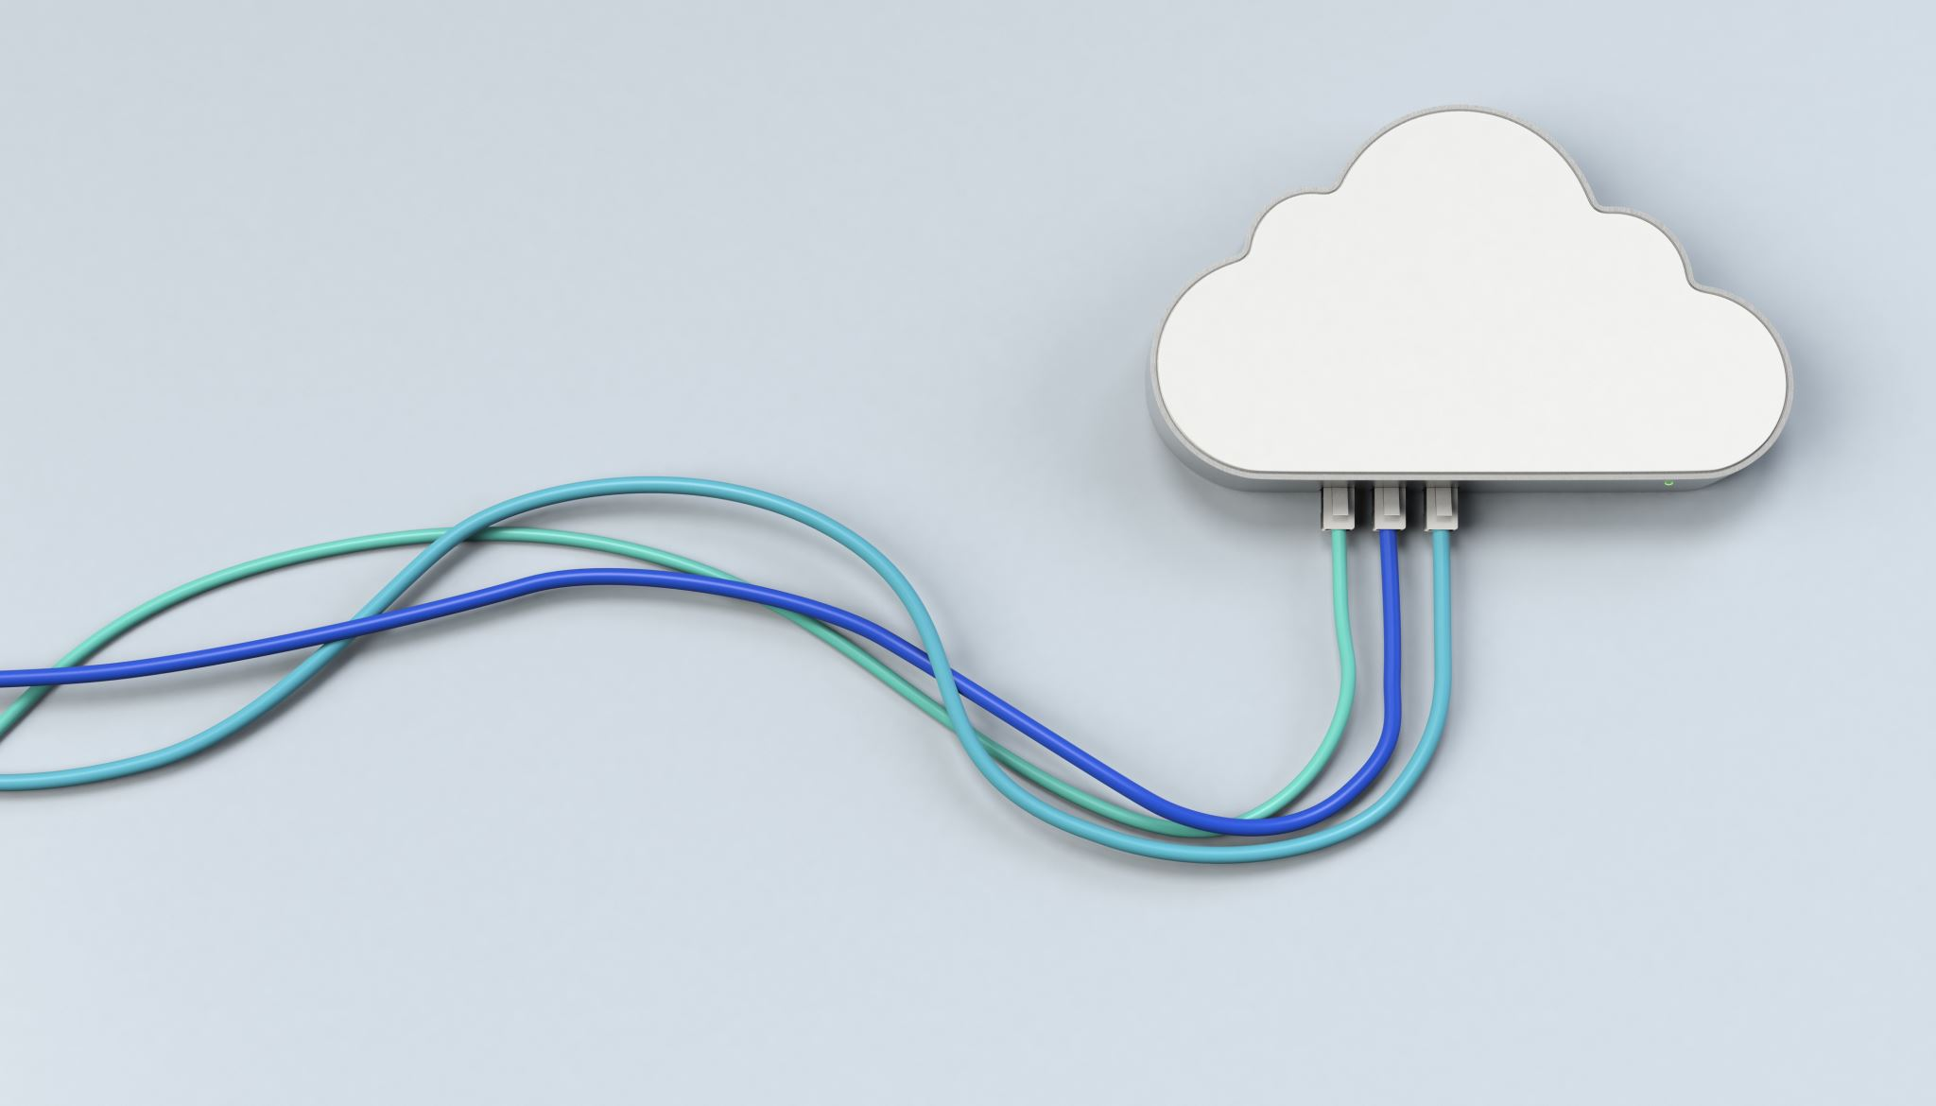

Cloud Computing Project
Submitted by: yasmine Fayed
Lubna Mohamed
oMAR eLdamrany
Mostafa Kamal

Slide 2
Objectives
What do you want to build?
How will it work from a user’s perspective?
What services will you use to build it and how they will work together?
How will your service scale?
Do we need a hardware?
Where can we get a dataset if needed?

Slide 3

What do you want to build?
We designed an architecture to have less load on our server.
So, we added two servers and a load balancer.

Slide 4

How will it work from a user’s perspective?
The webpages will load faster, because the load on the server isn’t huge

Slide 5

What services will you use to build it and how they will work together?

Slide 6
VPC, EC2, ELB, RDS, S3-Bucket
VPC (Virtual Private Cloud):
It is a virtual network that enables the user to launch AWS resources in a private network.
EC2 (Elastic Compute Cloud):
it provides scalable computing capacity in the cloud and is used to run applications.
ELB (Elastic Load Balancer):
It automatically distributes incoming traffic across multiple EC2 instances, increasing the availability and scalability of applications.
-RDS (Relational Database Service):
It is a managed database service that enables the user to set up, run, and scale a relational database.
-S3-Bucket (Simple Storage Service)
It's a highly available and scalable object storage that can be used to store and retrieve any amount of data.

Slide 7
Together, they enable the user to build a highly available, scalable and
reliable infrastructure. EC2 instances will be launched in a VPC,
an ELB is used to distribute the traffic to multiple EC2 instances,
an RDS is set up to store the websites (index.html), and
the S3 bucket is used to store the images displayed in the website.

Slide 8

Do we need a hardware?
Yes, we might need it later.

Slide 9
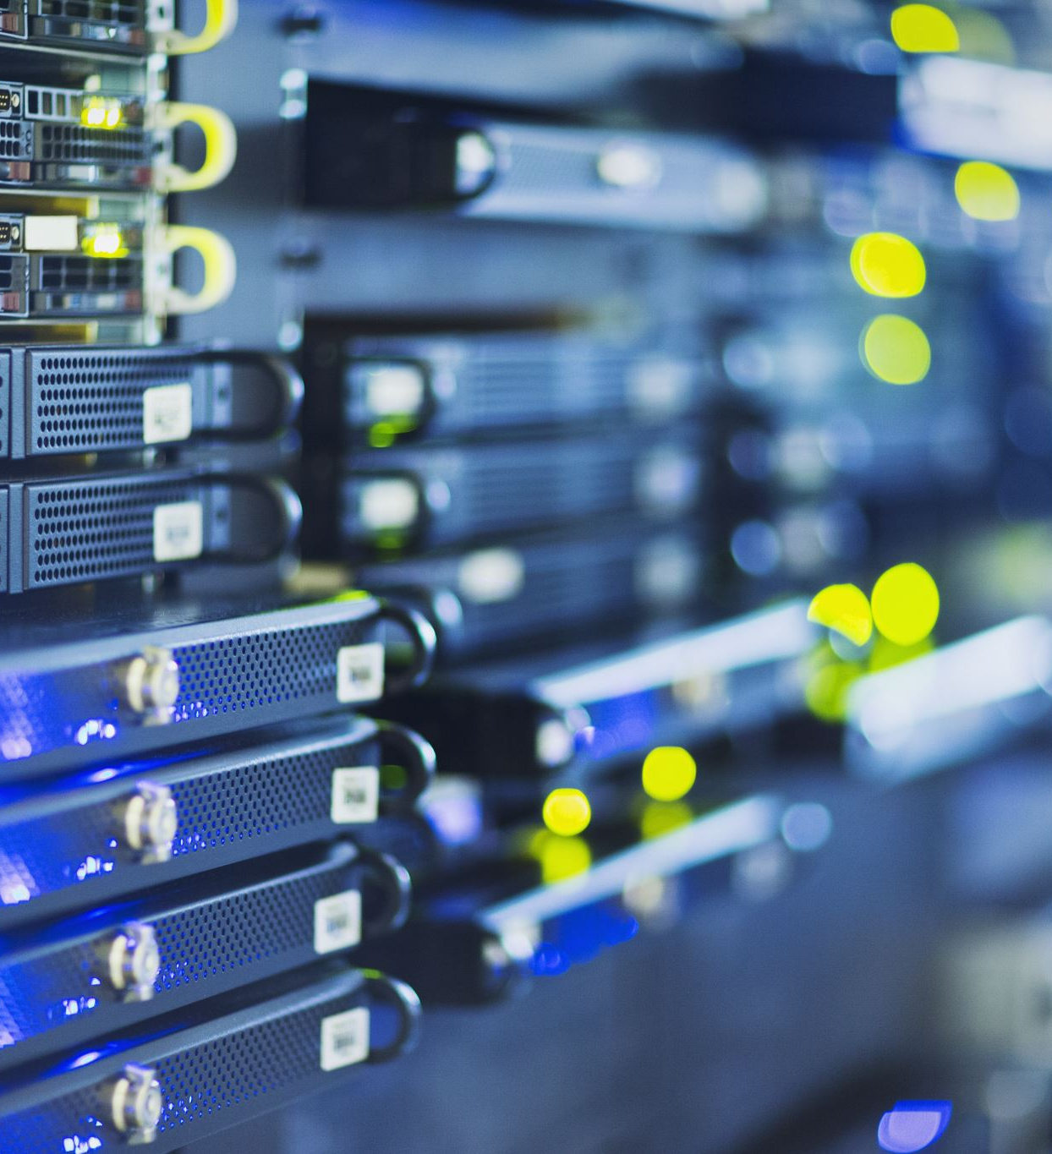
DO WE NEED a dataset if needed?
nO,WE DON’T NEED IN THIS PROJECT

Slide 10

How will your service scale?
As for now , it will be the used one that we discussed already.
For future services, an AI and other services can be implemented.

Slide 11

Thank you

